Slide 1
Transport Layer
Transport Layer
3-<number>

Slide 2
outline
Transport-layer services
Multiplexing and demultiplexing
Connectionless transport: UDP
Principles of reliable data transfer
Connection-oriented transport: TCP
  segment structure
  reliable data transfer
  flow control
  connection management
Principles of congestion control
TCP congestion control
Transport Layer
3-<number>

Slide 3





Transport services and protocols
provide logical communication between app processes running on different hosts
transport protocols run in end systems
  send side: breaks app messages into segments, passes to network layer
  rcv side: reassembles segments into messages, passes to app layer
more than one transport protocol available to apps
  Internet: TCP and UDP
application
transport
network
data link
physical
network
data link
physical
network
data link
physical
network
data link
physical
logical end-end transport
network
data link
physical
network
data link
physical
application
transport
network
data link
physical
Transport Layer
3-<number>

Slide 4
Transport vs. network layer
network layer: logical communication between hosts
transport layer: logical communication between processes
  relies on, enhances, network layer services
Household analogy:
12 kids sending letters to 12 kids
processes = kids
app messages = letters in envelopes
hosts = houses
transport protocol = Ann and Bill
network-layer protocol = postal service
Transport Layer
3-<number>

Slide 5
Internet transport-layer protocols
reliable, in-order delivery (TCP)
  congestion control
  flow control
  connection setup
unreliable, unordered delivery: UDP
  no-frills extension of “best-effort” IP
services not available:
  delay guarantees
  bandwidth guarantees
application
transport
network
data link
physical
network
data link
physical
network
data link
physical
network
data link
physical
logical end-end transport
network
data link
physical
network
data link
physical
application
transport
network
data link
physical
Transport Layer
3-<number>

Slide 6
outline
Transport-layer services
Multiplexing and demultiplexing
Connectionless transport: UDP
Principles of reliable data transfer
Connection-oriented transport: TCP
  segment structure
  reliable data transfer
  flow control
  connection management
Principles of congestion control
TCP congestion control
Transport Layer
3-<number>

Slide 7
Multiplexing/demultiplexing
Demultiplexing at rcv host:
Multiplexing at send host:
delivering received segments
to correct socket
gathering data from multiple
sockets, enveloping data with
header (later used for
demultiplexing)
= socket
= process
application
application
application
P4
P3
P1
P2
P1
transport
transport
transport
network
network
network
link
link
link
physical
physical
physical
host 1
host 2
host 3
Transport Layer
3-<number>

Slide 8
How demultiplexing works
host receives IP datagrams
  each datagram has source IP address, destination IP address
  each datagram carries 1 transport-layer segment
  each segment has source, destination port number
host uses IP addresses & port numbers to direct segment to appropriate socket
32 bits
source port #
dest port #
other header fields
application
data
(message)
TCP/UDP segment format
Transport Layer
3-<number>

Slide 9
Connectionless demultiplexing
When host receives UDP segment:
  checks destination port number in segment
  directs UDP segment to socket with that port number
IP datagrams with different source IP addresses and/or source port numbers directed to same socket
Create sockets with port numbers:
DatagramSocket mySocket1 = new DatagramSocket(99111);
DatagramSocket mySocket2 = new DatagramSocket(99222);
UDP socket identified by two-tuple:
(dest IP address, dest port number)
Transport Layer
3-<number>

Slide 10
Connectionless demux (cont)
DatagramSocket serverSocket = new DatagramSocket(6428);
P2
P1
P3
P1
SP: 6428
SP: 6428
DP: 9157
DP: 5775
SP: 9157
SP: 5775
client
IP: A
DP: 6428
server
IP: C
DP: 6428
Client
IP:B
SP provides “return address”
Transport Layer
3-<number>

Slide 11
Connection-oriented demux
TCP socket identified by 4-tuple:
  source IP address
  source port number
  dest IP address
  dest port number
recv host uses all four values to direct segment to appropriate socket
Server host support many simultaneous TCP sockets:
  each socket identified by its own 4-tuple
Web servers have different sockets for each connecting client
  non-persistent HTTP will have different socket for each request
Transport Layer
3-<number>

Slide 12
Connection-oriented demux (cont)
P1
P4
P5
P6
P2
P1
P3
SP: 5775
DP: 80
S-IP: B
D-IP:C
SP: 9157
SP: 9157
client
IP: A
DP: 80
server
IP: C
DP: 80
Client
IP:B
S-IP: A
S-IP: B
D-IP:C
D-IP:C
Transport Layer
3-<number>

Slide 13
outline
Transport-layer services
Multiplexing and demultiplexing
Connectionless transport: UDP
Principles of reliable data transfer
Connection-oriented transport: TCP
  segment structure
  reliable data transfer
  flow control
  connection management
Principles of congestion control
TCP congestion control
Transport Layer
3-<number>

Slide 14
UDP: User Datagram Protocol [RFC 768]
“no frills,” “bare bones” Internet transport protocol
“best effort” service, UDP segments may be:
  lost
  delivered out of order to app
connectionless:
  no handshaking between UDP sender, receiver
  each UDP segment handled independently of others
Why is there a UDP?
no connection establishment (which can add delay)
simple: no connection state at sender, receiver
small segment header
no congestion control: UDP can blast away as fast as desired
Transport Layer
3-<number>

Slide 15
UDP: more
often used for streaming multimedia apps
  loss tolerant
  rate sensitive
other UDP uses
  DNS
  SNMP
Is reliability possible using UDP
reliable transfer over UDP: add reliability at application layer
  application-specific error recovery!
32 bits
Length, in
bytes of UDP
segment,
including
header
source port #
dest port #
length
checksum
Application
data
(message)
UDP segment format
Transport Layer
3-<number>
Notes:
Checksum: detect “errors” (e.g., flipped bits) in transmitted segment (note: used at transport layer only)
The simplest checksum algorithm breaks the data into "words" with a fixed number of bits, and then computes the exclusive or of all those words.

Slide 16
outline
3.1 Transport-layer services
3.2 Multiplexing and demultiplexing
3.3 Connectionless transport: UDP
3.4 Principles of reliable data transfer
3.5 Connection-oriented transport: TCP
  segment structure
  reliable data transfer
  flow control
  connection management
3.6 Principles of congestion control
3.7 TCP congestion control
Transport Layer
3-<number>

Slide 17

Principles of Reliable data transfer
important in app., transport, link layers
top-10 list of important networking topics!
characteristics of unreliable channel will determine complexity of reliable data transfer protocol (rdt)
Transport Layer
3-<number>

Slide 18
Principles of Reliable data transfer
important in app., transport, link layers
top-10 list of important networking topics!
characteristics of unreliable channel will determine complexity of reliable data transfer protocol (rdt)
Transport Layer
3-<number>

Slide 19
Principles of Reliable data transfer
important in app., transport, link layers
top-10 list of important networking topics!
characteristics of unreliable channel will determine complexity of reliable data transfer protocol (rdt)
Transport Layer
3-<number>

Slide 20

Reliable data transfer: getting started
rdt_send(): called from above, (e.g., by app.). Passed data to
deliver to receiver upper layer
deliver_data(): called by rdt to deliver data to upper
send
side
receive
side
udt_send(): called by rdt,
to transfer packet over
unreliable channel to receiver
rdt_rcv(): called when packet arrives on rcv-side of channel
Transport Layer
3-<number>

Slide 21
Reliable data transfer: getting started
We’ll:
incrementally develop sender, receiver sides of reliable data transfer protocol (rdt)
consider only unidirectional data transfer
  but control info will flow on both directions!
use finite state machines (FSM) to specify sender, receiver
event causing state transition
actions taken on state transition
state: when in this “state” next state uniquely determined by next event
state
1
state
2
event
actions
Transport Layer
3-<number>

Slide 22
Rdt1.0: reliable transfer over a reliable channel
underlying channel perfectly reliable
  no bit errors
  no loss of packets
separate FSMs for sender, receiver:
  sender sends data into underlying channel
  receiver read data from underlying channel
Wait for call from above
rdt_send(data)
Wait for call from below
rdt_rcv(packet)
extract (packet,data)
deliver_data(data)
packet = make_pkt(data)
udt_send(packet)
sender
receiver
Transport Layer
3-<number>

Slide 23
Rdt2.0: channel with bit errors
underlying channel may flip bits in packet
  checksum to detect bit errors
the question: how to recover from errors:
  acknowledgements (ACKs): receiver explicitly tells sender that pkt received OK
  negative acknowledgements (NAKs): receiver explicitly tells sender that pkt had errors
  sender retransmits pkt on receipt of NAK
new mechanisms in rdt2.0 (beyond rdt1.0):
  error detection
  receiver feedback: control msgs (ACK,NAK) rcvr->sender
Transport Layer
3-<number>

Slide 24
rdt2.0: FSM specification
rdt_send(data)
snkpkt = make_pkt(data, checksum)
udt_send(sndpkt)
receiver
rdt_rcv(rcvpkt) &&
isNAK(rcvpkt)
Wait for call from above
Wait for ACK or NAK
rdt_rcv(rcvpkt) &&
corrupt(rcvpkt)
udt_send(sndpkt)
udt_send(NAK)
rdt_rcv(rcvpkt) && isACK(rcvpkt)
Λ
Wait for call from below
sender
rdt_rcv(rcvpkt) &&
notcorrupt(rcvpkt)
extract(rcvpkt,data)
deliver_data(data)
udt_send(ACK)
Transport Layer
3-<number>

Slide 25
rdt2.0: operation with no errors
rdt_send(data)
snkpkt = make_pkt(data, checksum)
udt_send(sndpkt)
rdt_rcv(rcvpkt) &&
isNAK(rcvpkt)
Wait for call from above
Wait for ACK or NAK
rdt_rcv(rcvpkt) &&
corrupt(rcvpkt)
udt_send(sndpkt)
udt_send(NAK)
rdt_rcv(rcvpkt) && isACK(rcvpkt)
Wait for call from below
Λ
rdt_rcv(rcvpkt) &&
notcorrupt(rcvpkt)
extract(rcvpkt,data)
deliver_data(data)
udt_send(ACK)
Transport Layer
3-<number>

Slide 26
rdt2.0: error scenario
rdt_send(data)
snkpkt = make_pkt(data, checksum)
udt_send(sndpkt)
rdt_rcv(rcvpkt) &&
isNAK(rcvpkt)
Wait for call from above
Wait for ACK or NAK
rdt_rcv(rcvpkt) &&
corrupt(rcvpkt)
udt_send(sndpkt)
udt_send(NAK)
rdt_rcv(rcvpkt) && isACK(rcvpkt)
Wait for call from below
Λ
rdt_rcv(rcvpkt) &&
notcorrupt(rcvpkt)
extract(rcvpkt,data)
deliver_data(data)
udt_send(ACK)
Transport Layer
3-<number>

Slide 27
rdt2.0 has a fatal flaw!
What happens if ACK/NAK corrupted?
sender doesn’t know what happened at receiver!
can’t just retransmit: possible duplicate
Handling duplicates:
sender retransmits current pkt if ACK/NAK garbled
sender adds sequence number to each pkt
receiver discards (doesn’t deliver up) duplicate pkt
stop and wait
Sender sends one packet,
then waits for receiver
response
Transport Layer
3-<number>

Slide 28
rdt2.1: sender, handles garbled ACK/NAKs
rdt_send(data)
sndpkt = make_pkt(0, data, checksum)
udt_send(sndpkt)
rdt_rcv(rcvpkt) &&
( corrupt(rcvpkt) ||
isNAK(rcvpkt) )
Wait for call 0 from above
Wait for ACK or NAK 0
udt_send(sndpkt)
rdt_rcv(rcvpkt)
&& notcorrupt(rcvpkt)
&& isACK(rcvpkt)
rdt_rcv(rcvpkt)
&& notcorrupt(rcvpkt)
&& isACK(rcvpkt)
Λ
Λ
Wait for ACK or NAK 1
Wait for
call 1 from above
rdt_rcv(rcvpkt) &&
( corrupt(rcvpkt) ||
isNAK(rcvpkt) )
rdt_send(data)
udt_send(sndpkt)
sndpkt = make_pkt(1, data, checksum)
udt_send(sndpkt)
Transport Layer
3-<number>

Slide 29
rdt2.1: receiver, handles garbled ACK/NAKs
rdt_rcv(rcvpkt) && notcorrupt(rcvpkt)
&& has_seq0(rcvpkt)
extract(rcvpkt,data)
deliver_data(data)
sndpkt = make_pkt(ACK, chksum)
udt_send(sndpkt)
rdt_rcv(rcvpkt) && (corrupt(rcvpkt)
rdt_rcv(rcvpkt) && (corrupt(rcvpkt)
sndpkt = make_pkt(NAK, chksum)
udt_send(sndpkt)
sndpkt = make_pkt(NAK, chksum)
udt_send(sndpkt)
Wait for
0 from below
Wait for
1 from below
rdt_rcv(rcvpkt) &&
not corrupt(rcvpkt) &&
has_seq1(rcvpkt)
rdt_rcv(rcvpkt) &&
not corrupt(rcvpkt) &&
has_seq0(rcvpkt)
sndpkt = make_pkt(ACK, chksum)
udt_send(sndpkt)
sndpkt = make_pkt(ACK, chksum)
udt_send(sndpkt)
rdt_rcv(rcvpkt) && notcorrupt(rcvpkt)
&& has_seq1(rcvpkt)
extract(rcvpkt,data)
deliver_data(data)
sndpkt = make_pkt(ACK, chksum)
udt_send(sndpkt)
Transport Layer
3-<number>

Slide 30
rdt2.1: discussion
Sender:
seq # added to pkt
two seq. #’s (0,1) will suffice.
must check if received ACK/NAK corrupted
twice as many states
  state must “remember” whether “current” pkt has 0 or 1 seq. #
Receiver:
must check if received packet is duplicate
  state indicates whether 0 or 1 is expected pkt seq #
note: receiver can not know if its last ACK/NAK received OK at sender
Transport Layer
3-<number>

Slide 31
rdt2.2: a NAK-free protocol
same functionality as rdt2.1, using ACKs only
instead of NAK, receiver sends ACK for last pkt received OK
  receiver must explicitly include seq # of pkt being ACKed
duplicate ACK at sender results in same action as NAK: retransmit current pkt
Transport Layer
3-<number>

Slide 32
rdt2.2: sender, receiver fragments
rdt_send(data)
sndpkt = make_pkt(0, data, checksum)
udt_send(sndpkt)
rdt_rcv(rcvpkt) &&
( corrupt(rcvpkt) ||
isACK(rcvpkt,1) )
Wait for call 0 from above
Wait for ACK
0
udt_send(sndpkt)
sender FSM
fragment
rdt_rcv(rcvpkt)
&& notcorrupt(rcvpkt)
&& isACK(rcvpkt,0)
rdt_rcv(rcvpkt) &&
(corrupt(rcvpkt) ||
has_seq1(rcvpkt))
Λ
Wait for
0 from below
receiver FSM
fragment
udt_send(sndpkt)
rdt_rcv(rcvpkt) && notcorrupt(rcvpkt)
&& has_seq1(rcvpkt)
extract(rcvpkt,data)
deliver_data(data)
sndpkt = make_pkt(ACK1, chksum)
udt_send(sndpkt)
Transport Layer
3-<number>

Slide 33
rdt3.0: channels with errors and loss
New assumption: underlying channel can also lose packets (data or ACKs)
  checksum, seq. #, ACKs, retransmissions will be of help, but not enough
Approach: sender waits “reasonable” amount of time for ACK
retransmits if no ACK received in this time
if pkt (or ACK) just delayed (not lost):
  retransmission will be duplicate, but use of seq. #’s already handles this
  receiver must specify seq # of pkt being ACKed
requires countdown timer
Transport Layer
3-<number>

Slide 34
rdt3.0 sender
rdt_send(data)
rdt_rcv(rcvpkt) &&
( corrupt(rcvpkt) ||
isACK(rcvpkt,1) )
sndpkt = make_pkt(0, data, checksum)
udt_send(sndpkt)
start_timer
rdt_rcv(rcvpkt)
Λ
Λ
Wait for
call 0from above
Wait for ACK0
timeout
udt_send(sndpkt)
start_timer
rdt_rcv(rcvpkt)
&& notcorrupt(rcvpkt)
&& isACK(rcvpkt,1)
rdt_rcv(rcvpkt)
&& notcorrupt(rcvpkt)
&& isACK(rcvpkt,0)
stop_timer
stop_timer
Wait for ACK1
Wait for
call 1 from above
timeout
udt_send(sndpkt)
start_timer
rdt_rcv(rcvpkt)
rdt_send(data)
Λ
rdt_rcv(rcvpkt) &&
( corrupt(rcvpkt) ||
isACK(rcvpkt,0) )
sndpkt = make_pkt(1, data, checksum)
udt_send(sndpkt)
start_timer
Λ
Transport Layer
3-<number>

Slide 35

rdt3.0 in action
Transport Layer
3-<number>

Slide 36

rdt3.0 in action
Transport Layer
3-<number>

Slide 37

Performance of rdt3.0
rdt3.0 works, but performance is poor
example: 1 Gbps link, 15 ms e-e prop. delay, 1KB packet:
T
=
L (packet length in bits)
8kb/pkt
transmit
=
= 8 microsec
R (transmission rate, bps)
10**9 b/sec
  U _{sender}: fraction of time sender busy sending
  1KB pkt every 30 msec -> 33kB/sec thruput over 1 Gbps link
  network protocol limits use of physical resources!
Transport Layer
3-<number>
Notes:
.2Mbps

Slide 38
rdt3.0: stop-and-wait operation
sender
receiver
first packet bit transmitted, t = 0
last packet bit transmitted, t = L / R
first packet bit arrives
RTT
last packet bit arrives, send ACK
ACK arrives, send next
packet, t = RTT + L / R
Transport Layer
3-<number>

Slide 39

Pipelined protocols
Pipelining: sender allows multiple, “in-flight”, yet-to-be-acknowledged pkts
  range of sequence numbers must be increased
  buffering at sender and/or receiver
Two generic forms of pipelined protocols: go-Back-N, selective repeat
Transport Layer
3-<number>

Slide 40

Pipelining: increased utilization
sender
receiver
first packet bit transmitted, t = 0
last bit transmitted, t = L / R
first packet bit arrives
RTT
last packet bit arrives, send ACK
last bit of 2nd packet arrives, send ACK
last bit of 3rd packet arrives, send ACK
ACK arrives, send next
packet, t = RTT + L / R
Increase utilization
by a factor of 3!
Transport Layer
3-<number>

Slide 41

Go-Back-N
Sender:
k-bit seq # in pkt header
“window” of up to N, consecutive unack’ed pkts allowed
ACK(n): ACKs all pkts up to, including seq # n - “cumulative ACK”
  may receive duplicate ACKs
timer for each in-flight pkt
timeout(n): retransmit pkt n and all higher seq # pkts in window
Transport Layer
3-<number>

Slide 42
GBN: sender extended FSM
rdt_send(data)
if (nextseqnum < base+N) {
sndpkt[nextseqnum] = make_pkt(nextseqnum,data,chksum)
udt_send(sndpkt[nextseqnum])
if (base == nextseqnum)
start_timer
nextseqnum++
}
else
refuse_data(data)
Λ
base=1
nextseqnum=1
timeout
Wait
start_timer
udt_send(sndpkt[base])
udt_send(sndpkt[base+1])
…
udt_send(sndpkt[nextseqnum-1])
rdt_rcv(rcvpkt)
&& corrupt(rcvpkt)
rdt_rcv(rcvpkt) &&
notcorrupt(rcvpkt)
base = getacknum(rcvpkt)+1
If (base == nextseqnum)
stop_timer
else
start_timer
Transport Layer
3-<number>

Slide 43
GBN: receiver extended FSM
default
udt_send(sndpkt)
rdt_rcv(rcvpkt)
&& notcurrupt(rcvpkt)
&& hasseqnum(rcvpkt,expectedseqnum)
Λ
Wait
extract(rcvpkt,data)
deliver_data(data)
sndpkt = make_pkt(expectedseqnum,ACK,chksum)
udt_send(sndpkt)
expectedseqnum++
expectedseqnum=1
sndpkt =
make_pkt(expectedseqnum,ACK,chksum)
ACK-only: always send ACK for correctly-received pkt with highest in-order seq #
  may generate duplicate ACKs
  need only remember expectedseqnum
out-of-order pkt:
  discard (don’t buffer) -> no receiver buffering!
  Re-ACK pkt with highest in-order seq #
Transport Layer
3-<number>

Slide 44

GBN in action
Transport Layer
3-<number>

Slide 45
Selective Repeat
receiver individually acknowledges all correctly received pkts
  buffers pkts, as needed, for eventual in-order delivery to upper layer
sender only resends pkts for which ACK not received
  sender timer for each unACKed pkt
sender window
  N consecutive seq #’s
  again limits seq #s of sent, unACKed pkts
Transport Layer
3-<number>

Slide 46

Selective repeat: sender, receiver windows
Transport Layer
3-<number>

Slide 47
Selective repeat
sender
receiver
data from above :
if next available seq # in window, send pkt
timeout(n):
resend pkt n, restart timer
ACK(n) in [sendbase,sendbase+N]:
mark pkt n as received
if n smallest unACKed pkt, advance window base to next unACKed seq #
pkt n in [rcvbase, rcvbase+N-1]
send ACK(n)
out-of-order: buffer
in-order: deliver (also deliver buffered, in-order pkts), advance window to next not-yet-received pkt
pkt n in [rcvbase-N,rcvbase-1]
ACK(n)
otherwise:
ignore
Transport Layer
3-<number>

Slide 48

Selective repeat in action
Transport Layer
3-<number>

Slide 49

Selective repeat: dilemma
Example:
seq #’s: 0, 1, 2, 3
window size=3
receiver sees no difference in two scenarios!
incorrectly passes duplicate data as new in (a)
Transport Layer
3-<number>

Slide 50
outline
Transport-layer services
Multiplexing and de-multiplexing
Connectionless transport: UDP
Principles of reliable data transfer
Connection-oriented transport: TCP
  segment structure
  reliable data transfer
  flow control
  connection management
Principles of congestion control
TCP congestion control
Transport Layer
3-<number>

Slide 51

TCP: Overview RFCs: 793, 1122, 1323, 2018, 2581
point-to-point:
  one sender, one receiver
reliable, in-order byte steam:
  no “message boundaries”
pipelined:
  TCP congestion and flow control set window size
send & receive buffers
full duplex data:
  bi-directional data flow in same connection
connection-oriented:
  handshaking (exchange of control msgs) init’s sender, receiver state before data exchange
flow controlled:
  sender will not overwhelm receiver
Transport Layer
3-<number>

Slide 52
TCP segment structure
32 bits
URG: urgent data
(generally not used)
source port #
dest port #
sequence number
ACK: ACK #
valid
acknowledgement number
head
len
not
used
U
Receive window
A
PSH: push data now
(generally not used)
P
R
S
F
# bytes
rcvr willing
to accept
checksum
Urg data pnter
RST, SYN, FIN:
connection estab
(setup, teardown
commands)
Options (variable length)
application
data
(variable length)
Internet
checksum
(as in UDP)
Transport Layer
3-<number>
Notes:
Head len (4 bits) – specifies the size of the TCP header in 32-bit words. The minimum size header is 5 words and the maximum is 15 words thus giving the minimum size of 20 bytes and maximum of 60 bytes. This field gets its name from the fact that it is also the offset from the start of the TCP segment to the actual data.

Slide 53
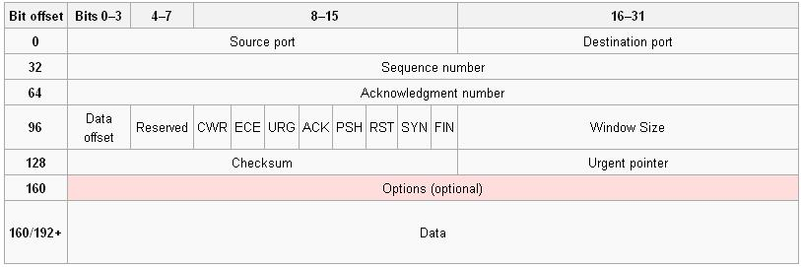
TCP segment structure
Data offset (4 bits) – specifies the size of the TCP header in 32-bit words. The minimum size header is 5 words and the maximum is 15 words thus giving the minimum size of 20 bytes and maximum of 60 bytes
Notes:
Source port (16 bits) – identifies the sending port
Destination port (16 bits) – identifies the receiving port
Sequence number (32 bits) – has a dual role
If the SYN flag is set, then this is the initial sequence number. The sequence number of the actual first data byte will then be this sequence number plus 1.
If the SYN flag is not set, then this is the sequence number of the first data byte
Acknowledgement number (32 bits) – if the ACK flag is set then the value of this field is the next expected byte that the receiver is expecting.
Data offset (4 bits) – specifies the size of the TCP header in 32-bit words. The minimum size header is 5 words and the maximum is 15 words thus giving the minimum size of 20 bytes and maximum of 60 bytes. This field gets its name from the fact that it is also the offset from the start of the TCP segment to the actual data.
Reserved (4 bits) – for future use and should be set to zero
Flags (8 bits) (aka Control bits) – contains 8 1-bit flags
CWR (1 bit) – Congestion Window Reduced (CWR) flag is set by the sending host to indicate that it received a TCP segment with the ECE flag set (added to header by RFC 3168).
ECE (ECN-Echo) (1 bit) – indicate that the TCP peer is ECN capable during 3-way handshake (added to header by RFC 3168).
URG (1 bit) – indicates that the URGent pointer field is significant
ACK (1 bit) – indicates that the ACKnowledgment field is significant
PSH (1 bit) – Push function
RST (1 bit) – Reset the connection
SYN (1 bit) – Synchronize sequence numbers
FIN (1 bit) – No more data from sender
Window (16 bits) – the size of the receive window, which specifies the number of bytes (beyond the sequence number in the acknowledgment field) that the receiver is currently willing to receive (see Flow control)
Checksum (16 bits) – The 16-bit checksum field is used for error-checking of the header and data
Urgent pointer (16 bits) – if the URG flag is set, then this 16-bit field is an offset from the sequence number indicating the last urgent data byte
Options (Variable bits) – the total length of the option field must be a multiple of a 32-bit word and the data offset field adjusted appropriately
0 - End of options list
1 - No operation (NOP, Padding)
2 - Maximum segment size (see maximum segment size)
3 - Window scale (see window scaling for details)
4 - Selective Acknowledgement ok (see selective acknowledgments for details)
5 -
6 -
7 -
8 - Timestamp (see TCP Timestamps for details)
The last field is not a part of the header. The contents of this field are whatever the upper layer protocol wants but this protocol is not set in the header and is presumed based on the port selection.
Data (Variable bits): As you might expect, this is the payload, or data portion of a TCP packet. The payload may be any number of application layer protocols. The most common are HTTP, Telnet, SSH, FTP, but other popular protocols also use TCP.

Slide 54
TCP seq. #’s and ACKs
Seq. #’s:
  byte stream “number” of first byte in segment’s data
ACKs:
  seq # of next byte expected from other side
  cumulative ACK
Q: how receiver handles out-of-order segments
  A: TCP spec doesn’t say, - up to implementor
Host A
Host B
User
types
‘C’
Seq=42, ACK=79, data = ‘C’
host ACKs
receipt of
‘C’, echoes
back ‘C’
Seq=79, ACK=43, data = ‘C’
host ACKs
receipt
of echoed
‘C’
Seq=43, ACK=80
time
simple telnet scenario
Transport Layer
3-<number>

Slide 55
TCP Round Trip Time and Timeout
Q: how to set TCP timeout value?
longer than RTT
  but RTT varies
too short: premature timeout
  unnecessary retransmissions
too long: slow reaction to segment loss
Q: how to estimate RTT?
SampleRTT: measured time from segment transmission until ACK receipt
  ignore retransmissions
SampleRTT will vary, want estimated RTT “smoother”
  average several recent measurements, not just current SampleRTT
Transport Layer
3-<number>

Slide 56
TCP Round Trip Time and Timeout
EstimatedRTT = (1- α)*EstimatedRTT + α*SampleRTT
Exponential weighted moving average
influence of past sample decreases exponentially fast
typical value: α = 0.125
Transport Layer
3-<number>

Slide 57

Example RTT estimation:
Transport Layer
3-<number>

Slide 58
TCP Round Trip Time and Timeout
Setting the timeout
EstimtedRTT plus “safety margin”
  large variation in EstimatedRTT -> larger safety margin
first estimate of how much SampleRTT deviates from EstimatedRTT:
DevRTT = (1-β)*DevRTT +
β*|SampleRTT-EstimatedRTT|
(typically, β = 0.25)
Then set timeout interval:
TimeoutInterval = EstimatedRTT + 4*DevRTT
Transport Layer
3-<number>

Slide 59
Chapter 3 outline
3.1 Transport-layer services
3.2 Multiplexing and demultiplexing
3.3 Connectionless transport: UDP
3.4 Principles of reliable data transfer
3.5 Connection-oriented transport: TCP
  segment structure
  reliable data transfer
  flow control
  connection management
3.6 Principles of congestion control
3.7 TCP congestion control
Transport Layer
3-<number>

Slide 60
TCP reliable data transfer
TCP creates rdt service on top of IP’s unreliable service
Pipelined segments
Cumulative acks
TCP uses single retransmission timer
Retransmissions are triggered by:
  timeout events
  duplicate acks
Initially consider simplified TCP sender:
  ignore duplicate acks
  ignore flow control, congestion control
Transport Layer
3-<number>

Slide 61
TCP sender events:
data rcvd from app:
Create segment with seq #
seq # is byte-stream number of first data byte in segment
start timer if not already running (think of timer as for oldest unacked segment)
expiration interval: TimeOutInterval
timeout:
retransmit segment that caused timeout
restart timer
Ack rcvd:
If acknowledges previously unacked segments
  update what is known to be acked
  start timer if there are outstanding segments
Transport Layer
3-<number>

Slide 62
TCP sender
(simplified)
NextSeqNum = InitialSeqNum
SendBase = InitialSeqNum
loop (forever) {
switch(event)
event: data received from application above
create TCP segment with sequence number NextSeqNum
if (timer currently not running)
start timer
pass segment to IP
NextSeqNum = NextSeqNum + length(data)
event: timer timeout
retransmit not-yet-acknowledged segment with
smallest sequence number
start timer
event: ACK received, with ACK field value of y
if (y > SendBase) {
SendBase = y
if (there are currently not-yet-acknowledged segments)
start timer
}
} /* end of loop forever */
Comment:
SendBase-1: last
cumulatively
ack’ed byte
Example:
SendBase-1 = 71;
y= 73, so the rcvr
wants 73+ ;
y > SendBase, so
that new data is
acked
Transport Layer
3-<number>

Slide 63
TCP: retransmission scenarios
Host A
Host B
Host A
Host B
Seq=92, 8 bytes data
Seq=92, 8 bytes data
Seq=100, 20 bytes data
timeout
ACK=100
Seq=92 timeout
X
ACK=100
loss
ACK=120
Seq=92, 8 bytes data
Sendbase
= 100
Seq=92, 8 bytes data
SendBase
= 120
Seq=92 timeout
ACK=120
ACK=100
SendBase
= 100
SendBase
= 120
premature timeout
time
time
lost ACK scenario
Transport Layer
3-<number>

Slide 64
TCP retransmission scenarios (more)
Host A
Host B
Seq=92, 8 bytes data
ACK=100
timeout
Seq=100, 20 bytes data
X
loss
SendBase
= 120
ACK=120
time
Cumulative ACK scenario
Transport Layer
3-<number>

Slide 65
TCP ACK generation [RFC 1122, RFC 2581]
Event at Receiver
Arrival of in-order segment with
expected seq #. All data up to
expected seq # already ACKed
Arrival of in-order segment with
expected seq #. One other
segment has ACK pending
Arrival of out-of-order segment
higher-than-expect seq. # .
Gap detected
Arrival of segment that
partially or completely fills gap
TCP Receiver action
Delayed ACK. Wait up to 500ms
for next segment. If no next segment,
send ACK
Immediately send single cumulative
ACK, ACKing both in-order segments
Immediately send duplicate ACK,
indicating seq. # of next expected byte
Immediate send ACK, provided that
segment startsat lower end of gap
Transport Layer
3-<number>

Slide 66
Fast Retransmit
Time-out period often relatively long:
  long delay before resending lost packet
Detect lost segments via duplicate ACKs.
  Sender often sends many segments back-to-back
  If segment is lost, there will likely be many duplicate ACKs.
If sender receives 3 ACKs for the same data, it supposes that segment after ACKed data was lost:
  fast retransmit: resend segment before timer expires
Transport Layer
3-<number>

Slide 67
Fast retransmit algorithm:
event: ACK received, with ACK field value of y
if (y > SendBase) {
SendBase = y
if (there are currently not-yet-acknowledged segments)
start timer
}
else {
increment count of dup ACKs received for y
if (count of dup ACKs received for y = 3) {
resend segment with sequence number y
}
a duplicate ACK for
already ACKed segment
fast retransmit
Transport Layer
3-<number>

Slide 68
outline
3.1 Transport-layer services
3.2 Multiplexing and demultiplexing
3.3 Connectionless transport: UDP
3.4 Principles of reliable data transfer
3.5 Connection-oriented transport: TCP
  segment structure
  reliable data transfer
  flow control
  connection management
3.6 Principles of congestion control
3.7 TCP congestion control
Transport Layer
3-<number>

Slide 69

TCP Flow Control
flow control
sender won’t overflow
receiver’s buffer by
transmitting too much,
too fast
receive side of TCP connection has a receive buffer:
speed-matching service: matching the send rate to the receiving app’s drain rate
app process may be slow at reading from buffer
Transport Layer
3-<number>

Slide 70
TCP Flow control: how it works
Rcvr advertises spare room by including value of RcvWindow in segments
Sender limits unACKed data to RcvWindow
  guarantees receive buffer doesn’t overflow
(Suppose TCP receiver discards out-of-order segments)
spare room in buffer
= RcvWindow
= RcvBuffer-[LastByteRcvd - LastByteRead]
Transport Layer
3-<number>

Slide 71
Chapter 3 outline
3.1 Transport-layer services
3.2 Multiplexing and demultiplexing
3.3 Connectionless transport: UDP
3.4 Principles of reliable data transfer
3.5 Connection-oriented transport: TCP
  segment structure
  reliable data transfer
  flow control
  connection management
3.6 Principles of congestion control
3.7 TCP congestion control
Transport Layer
3-<number>

Slide 72
TCP Connection Management
Recall: TCP sender, receiver establish “connection” before exchanging data segments
initialize TCP variables:
  seq. #s
  buffers, flow control info (e.g. RcvWindow)
client: connection initiator
Socket clientSocket = new Socket("hostname","port number");
server: contacted by client
Socket connectionSocket = welcomeSocket.accept();
Three way handshake:
Step 1: client host sends TCP SYN segment to server
  specifies initial seq #
  no data
Step 2: server host receives SYN, replies with SYNACK segment
  server allocates buffers
  specifies server initial seq. #
Step 3: client receives SYNACK, replies with ACK segment, which may contain data
Transport Layer
3-<number>

Slide 73
TCP Connection Management (cont.)
Closing a connection:
client closes socket: clientSocket.close();
Step 1: client end system sends TCP FIN control segment to server
Step 2: server receives FIN, replies with ACK. Closes connection, sends FIN.
client
server
close
FIN
ACK
close
FIN
ACK
timed wait
closed
Transport Layer
3-<number>

Slide 74
TCP Connection Management (cont.)
Step 3: client receives FIN, replies with ACK.
  Enters “timed wait” - will respond with ACK to received FINs
Step 4: server, receives ACK. Connection closed.
client
server
closing
FIN
ACK
closing
FIN
ACK
timed wait
closed
closed
Transport Layer
3-<number>

Slide 75


TCP Connection Management (cont)
TCP server
lifecycle
TCP client
lifecycle
Transport Layer
3-<number>

Slide 76
Chapter 3 outline
3.1 Transport-layer services
3.2 Multiplexing and demultiplexing
3.3 Connectionless transport: UDP
3.4 Principles of reliable data transfer
3.5 Connection-oriented transport: TCP
  segment structure
  reliable data transfer
  flow control
  connection management
3.6 Principles of congestion control
3.7 TCP congestion control
Transport Layer
3-<number>

Slide 77
Principles of Congestion Control
Congestion:
informally: “too many sources sending too much data too fast for network to handle”
different from flow control!
manifestations:
  lost packets (buffer overflow at routers)
  long delays (queueing in router buffers)
a top-10 problem!
Transport Layer
3-<number>

Slide 78

Causes/costs of congestion: scenario 1
two senders, two receivers
one router, infinite buffers
no retransmission
Host A
λ_{in} : original data
λ_{out}
Host B
unlimited shared output link buffers
large delays when congested
maximum achievable throughput
Transport Layer
3-<number>

Slide 79
Causes/costs of congestion: scenario 2
one router, finite buffers
sender retransmission of lost packet
Host A
λ_{in} : original data
λ_{out}
λ'_{in} : original data, plus retransmitted data
Host B
finite shared output link buffers
Transport Layer
3-<number>

Slide 80
Causes/costs of congestion: scenario 2
λ
λ
always: (goodput)
“perfect” retransmission only when loss:
retransmission of delayed (not lost) packet makes larger (than perfect case) for same
=
in
out
λ
>
λ
in
out
λ
in
λ
out
R/2
R/2
R/2
R/3
λ_{out}
λ_{out}
λ_{out}
R/4
λ_{in}
R/2
λ_{in}
R/2
λ_{in}
R/2
a.
b.
c.
“costs” of congestion:
more work (retrans) for given “goodput”
unneeded retransmissions: link carries multiple copies of pkt
Transport Layer
3-<number>

Slide 81
Causes/costs of congestion: scenario 3
λ
four senders
multihop paths
timeout/retransmit
Q: what happens as and increase ?
λ
in
in
Host A
λ_{in} : original data
λ_{out}
λ'_{in} : original data, plus retransmitted data
finite shared output link buffers
Host B
Transport Layer
3-<number>

Slide 82

Causes/costs of congestion: scenario 3
Host A
λ_{out}
Host B
Another “cost” of congestion:
when packet dropped, any “upstream transmission capacity used for that packet was wasted!
Transport Layer
3-<number>

Slide 83
Approaches towards congestion control
Two broad approaches towards congestion control:
End-end congestion control:
no explicit feedback from network
congestion inferred from end-system observed loss, delay
approach taken by TCP
Network-assisted congestion control:
routers provide feedback to end systems
  single bit indicating congestion (SNA, DECbit, TCP/IP ECN, ATM)
  explicit rate sender should send at
Transport Layer
3-<number>

Slide 84
Case study: ATM ABR congestion control
ABR: available bit rate:
“elastic service”
if sender’s path “underloaded”:
  sender should use available bandwidth
if sender’s path congested:
  sender throttled to minimum guaranteed rate
RM (resource management) cells:
sent by sender, interspersed with data cells
bits in RM cell set by switches (“network-assisted”)
  NI bit: no increase in rate (mild congestion)
  CI bit: congestion indication
RM cells returned to sender by receiver, with bits intact
Transport Layer
3-<number>

Slide 85

Case study: ATM ABR congestion control
two-byte ER (explicit rate) field in RM cell
  congested switch may lower ER value in cell
  sender’ send rate thus minimum supportable rate on path
EFCI bit in data cells: set to 1 in congested switch
  if data cell preceding RM cell has EFCI set, sender sets CI bit in returned RM cell
Transport Layer
3-<number>

Slide 86
Chapter 3 outline
3.1 Transport-layer services
3.2 Multiplexing and demultiplexing
3.3 Connectionless transport: UDP
3.4 Principles of reliable data transfer
3.5 Connection-oriented transport: TCP
  segment structure
  reliable data transfer
  flow control
  connection management
3.6 Principles of congestion control
3.7 TCP congestion control
Transport Layer
3-<number>

Slide 87

TCP congestion control: additive increase, multiplicative decrease
Approach: increase transmission rate (window size), probing for usable bandwidth, until loss occurs
  additive increase: increase CongWin by 1 MSS every RTT until loss detected
  multiplicative decrease: cut CongWin in half after loss
Saw tooth
behavior: probing
for bandwidth
congestion window size
time
Transport Layer
3-<number>

Slide 88
TCP Congestion Control: details
sender limits transmission:
LastByteSent-LastByteAcked
≤ CongWin
Roughly,
CongWin is dynamic, function of perceived network congestion
How does sender perceive congestion?
loss event = timeout or 3 duplicate acks
TCP sender reduces rate (CongWin) after loss event
three mechanisms:
  AIMD
  slow start
  conservative after timeout events
CongWin
rate =
Bytes/sec
RTT
Transport Layer
3-<number>

Slide 89
TCP Slow Start
When connection begins, CongWin = 1 MSS
  Example: MSS = 500 bytes & RTT = 200 msec
  initial rate = 20 kbps
available bandwidth may be >> MSS/RTT
  desirable to quickly ramp up to respectable rate
When connection begins, increase rate exponentially fast until first loss event
Transport Layer
3-<number>

Slide 90
TCP Slow Start (more)
When connection begins, increase rate exponentially until first loss event:
  double CongWin every RTT
  done by incrementing CongWin for every ACK received
Summary: initial rate is slow but ramps up exponentially fast
Host A
Host B
one segment
RTT
two segments
four segments
time
Transport Layer
3-<number>

Slide 91

Refinement
Q: When should the exponential increase switch to linear?
A: When CongWin gets to 1/2 of its value before timeout.
Implementation:
Variable Threshold
At loss event, Threshold is set to 1/2 of CongWin just before loss event
Transport Layer
3-<number>

Slide 92
Refinement: inferring loss
After 3 dup ACKs:
  CongWin is cut in half
  window then grows linearly
But after timeout event:
  CongWin instead set to 1 MSS;
  window then grows exponentially
  to a threshold, then grows linearly
Philosophy:
3 dup ACKs indicates
network capable of
delivering some segments
timeout indicates a “more alarming” congestion scenario
Transport Layer
3-<number>

Slide 93
Summary: TCP Congestion Control
When CongWin is below Threshold, sender in slow-start phase, window grows exponentially.
When CongWin is above Threshold, sender is in congestion-avoidance phase, window grows linearly.
When a triple duplicate ACK occurs, Threshold set to CongWin/2 and CongWin set to Threshold.
When timeout occurs, Threshold set to CongWin/2 and CongWin is set to 1 MSS.
Transport Layer
3-<number>

Slide 94
TCP sender congestion control
State | Event | TCP Sender Action | Commentary
Slow Start (SS) | ACK receipt for previously unacked data | CongWin = CongWin + MSS, If (CongWin > Threshold) set state to “Congestion Avoidance” | Resulting in a doubling of CongWin every RTT
Congestion Avoidance (CA) | ACK receipt for previously unacked data | CongWin = CongWin+MSS * (MSS/CongWin) | Additive increase, resulting in increase of CongWin by 1 MSS every RTT
SS or CA | Loss event detected by triple duplicate ACK | Threshold = CongWin/2, CongWin = Threshold, Set state to “Congestion Avoidance” | Fast recovery, implementing multiplicative decrease. CongWin will not drop below 1 MSS.
SS or CA | Timeout | Threshold = CongWin/2, CongWin = 1 MSS, Set state to “Slow Start” | Enter slow start
SS or CA | Duplicate ACK | Increment duplicate ACK count for segment being acked | CongWin and Threshold not changed
Transport Layer
3-<number>

Slide 95
TCP throughput
What’s the average throughout of TCP as a function of window size and RTT?
  Ignore slow start
Let W be the window size when loss occurs.
When window is W, throughput is W/RTT
Just after loss, window drops to W/2, throughput to W/2RTT.
Average throughout: .75 W/RTT
Transport Layer
3-<number>

Slide 96

TCP Futures
Example: 1500 byte segments, 100ms RTT, want 10 Gbps throughput
Requires window size W = 83,333 in-flight segments
Throughput in terms of loss rate:
➜ L = 2·10⁻¹⁰ Wow
New versions of TCP for high-speed needed!
Transport Layer
3-<number>

Slide 97
TCP Fairness
Fairness goal: if K TCP sessions share same bottleneck link of bandwidth R, each should have average rate of R/K
TCP connection 1
TCP
connection 2
bottleneck
router
capacity R
Transport Layer
3-<number>

Slide 98
Why is TCP fair?
Two competing sessions:
Additive increase gives slope of 1, as throughout increases
multiplicative decrease decreases throughput proportionally
R
equal bandwidth share
loss: decrease window by factor of 2
congestion avoidance: additive increase
Connection 2 throughput
loss: decrease window by factor of 2
congestion avoidance: additive increase
Connection 1 throughput
R
Transport Layer
3-<number>

Slide 99
Fairness (more)
Fairness and UDP
Multimedia apps often do not use TCP
  do not want rate throttled by congestion control
Instead use UDP:
  pump audio/video at constant rate, tolerate packet loss
Research area: TCP friendly
Fairness and parallel TCP connections
nothing prevents app from opening parallel connections between 2 hosts.
Web browsers do this
Transport Layer
3-<number>

Slide 100
Delay modeling
Notation, assumptions:
Assume one link between client and server of rate R
S: MSS (bits)
O: object size (bits)
no retransmissions (no loss, no corruption)
Window size:
First assume: fixed congestion window, W segments
Then dynamic window, modeling slow start
Q: How long does it take to receive an object from a Web server after sending a request?
Ignoring congestion, delay is influenced by:
TCP connection establishment
data transmission delay
slow start
Transport Layer
3-<number>

Slide 101
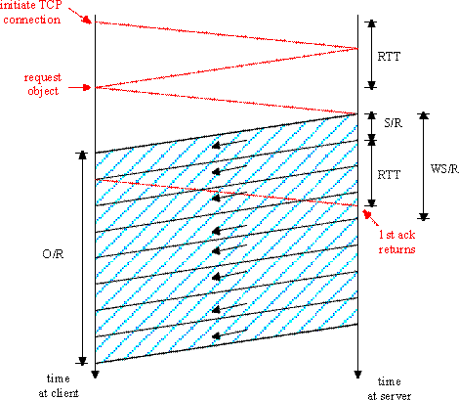
Fixed congestion window (1)
First case:
WS/R > RTT + S/R: ACK for first segment in window returns before window’s worth of data sent
delay = 2RTT + O/R
Transport Layer
3-<number>

Slide 102
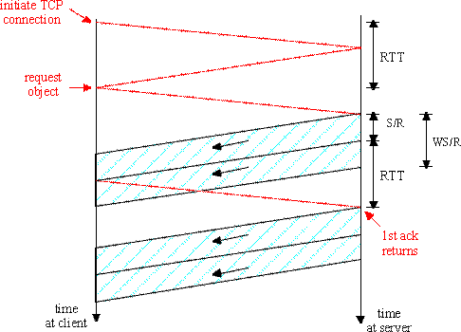
Fixed congestion window (2)
Second case:
WS/R < RTT + S/R: wait for ACK after sending window’s worth of data sent
delay = 2RTT + O/R
+ (K-1)[S/R + RTT - WS/R]
Transport Layer
3-<number>

Slide 103
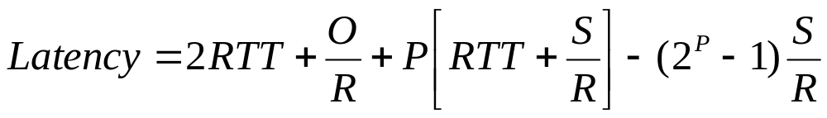

TCP Delay Modeling: Slow Start (1)
Now suppose window grows according to slow start
Will show that the delay for one object is:
where P is the number of times TCP idles at server:
- where Q is the number of times the server idles
if the object were of infinite size.
- and K is the number of windows that cover the object.
Transport Layer
3-<number>

Slide 104
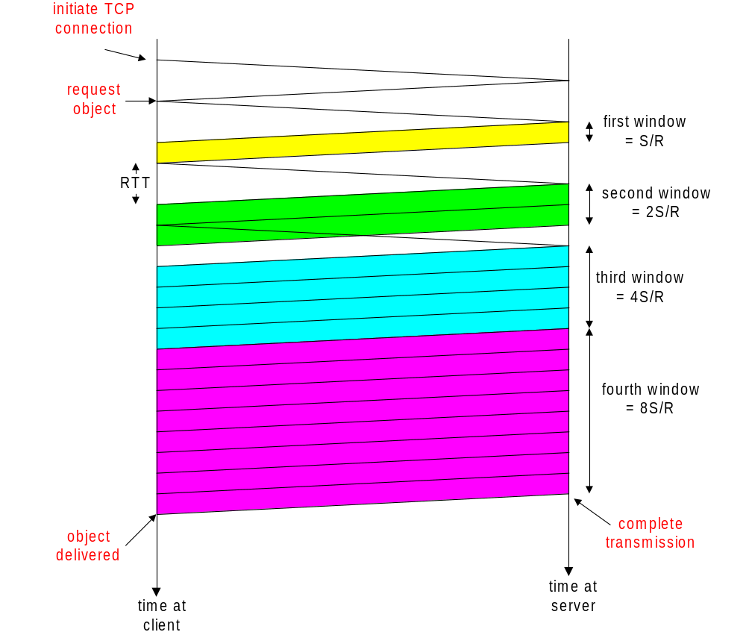
TCP Delay Modeling: Slow Start (2)
Delay components:
2 RTT for connection estab and request
O/R to transmit object
time server idles due to slow start
Server idles:
P = min{K-1,Q} times
Example:
O/S = 15 segments
K = 4 windows
Q = 2
P = min{K-1,Q} = 2
Server idles P=2 times
Transport Layer
3-<number>

Slide 105
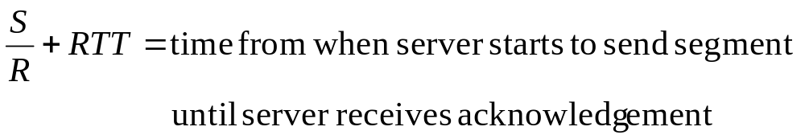
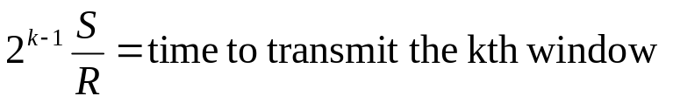
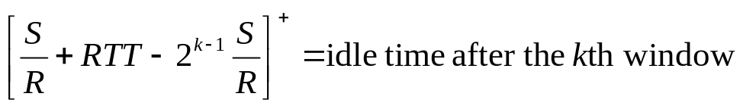
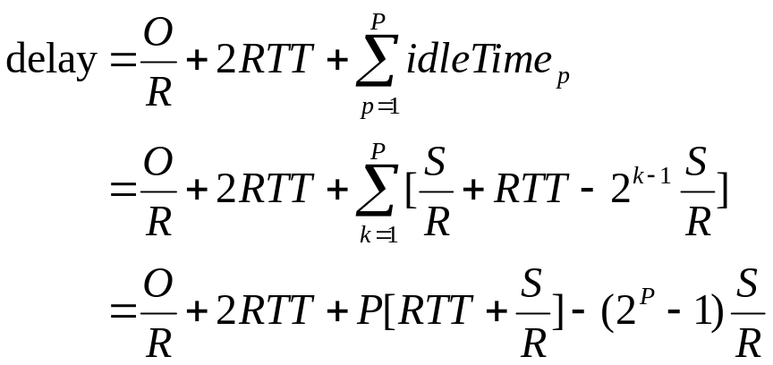
TCP Delay Modeling (3)
Transport Layer
3-<number>

Slide 106
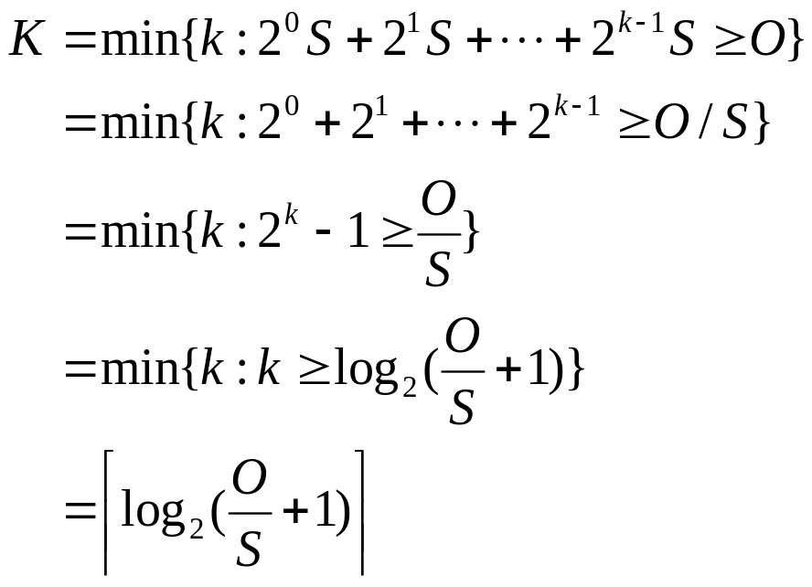
TCP Delay Modeling (4)
Recall K = number of windows that cover object
How do we calculate K ?
Calculation of Q, number of idles for infinite-size object,
is similar (see HW).
Transport Layer
3-<number>

Slide 107
HTTP Modeling
Assume Web page consists of:
  1 base HTML page (of size O bits)
  M images (each of size O bits)
Non-persistent HTTP:
  M+1 TCP connections in series
  Response time = (M+1)O/R + (M+1)2RTT + sum of idle times
Persistent HTTP:
  2 RTT to request and receive base HTML file
  1 RTT to request and receive M images
  Response time = (M+1)O/R + 3RTT + sum of idle times
Non-persistent HTTP with X parallel connections
  Suppose M/X integer.
  1 TCP connection for base file
  M/X sets of parallel connections for images.
  Response time = (M+1)O/R + (M/X + 1)2RTT + sum of idle times
Transport Layer
3-<number>

Slide 108
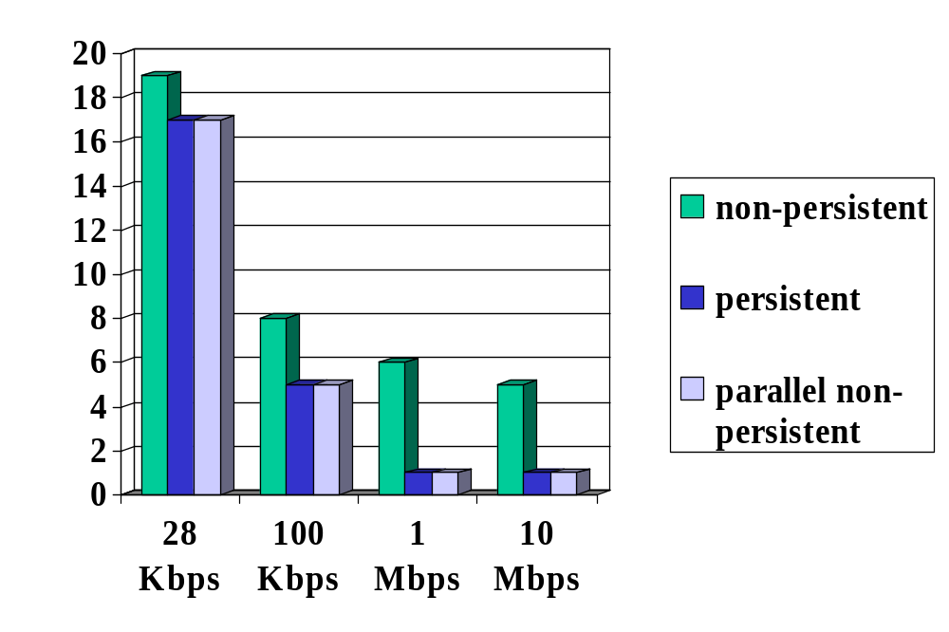
HTTP Response time (in seconds)
RTT = 100 msec, O = 5 Kbytes, M=10 and X=5
For low bandwidth, connection & response time dominated by transmission time.
Persistent connections only give minor improvement over parallel
connections.
Transport Layer
3-<number>

Slide 109
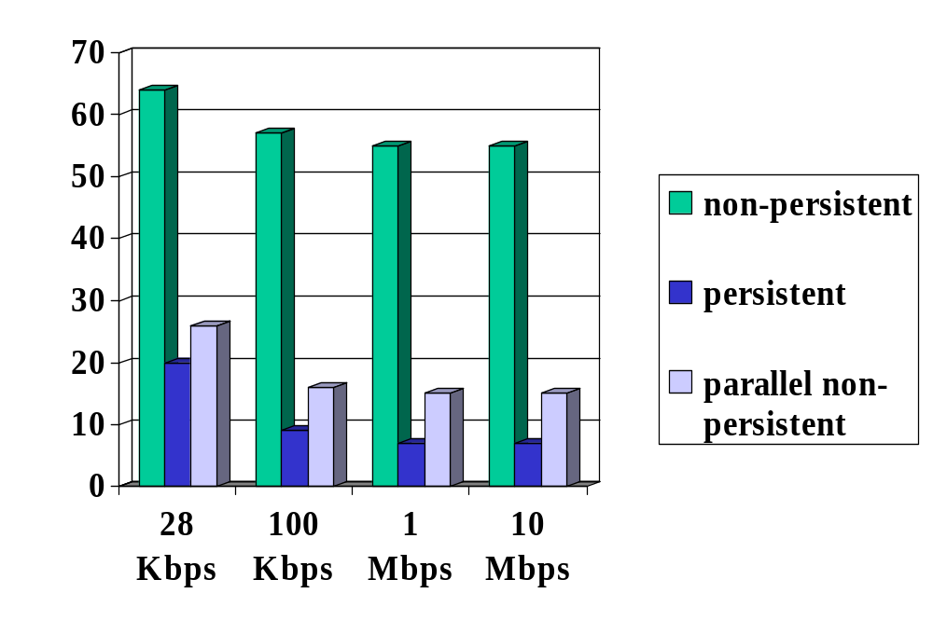
HTTP Response time (in seconds)
RTT =1 sec, O = 5 Kbytes, M=10 and X=5
For larger RTT, response time dominated by TCP establishment
& slow start delays. Persistent connections now give important
improvement: particularly in high delay•bandwidth networks.
Transport Layer
3-<number>

Slide 110
Chapter 3: Summary
principles behind transport layer services:
  multiplexing, demultiplexing
  reliable data transfer
  flow control
  congestion control
instantiation and implementation in the Internet
  UDP
  TCP
Next:
leaving the network “edge” (application, transport layers)
into the network “core”
Transport Layer
3-<number>

